Slide 1
TerrierExchange

Slide 2

Main Goal
Provide a platform for BU students to easily buy and sell their textbooks

Slide 3
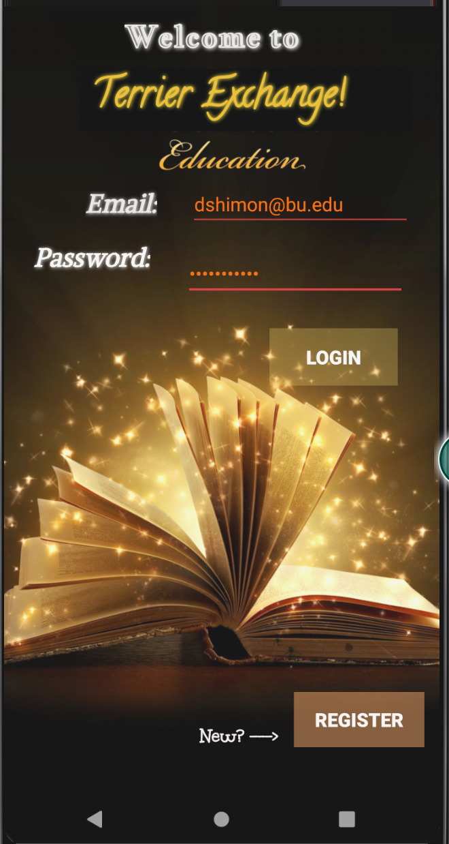
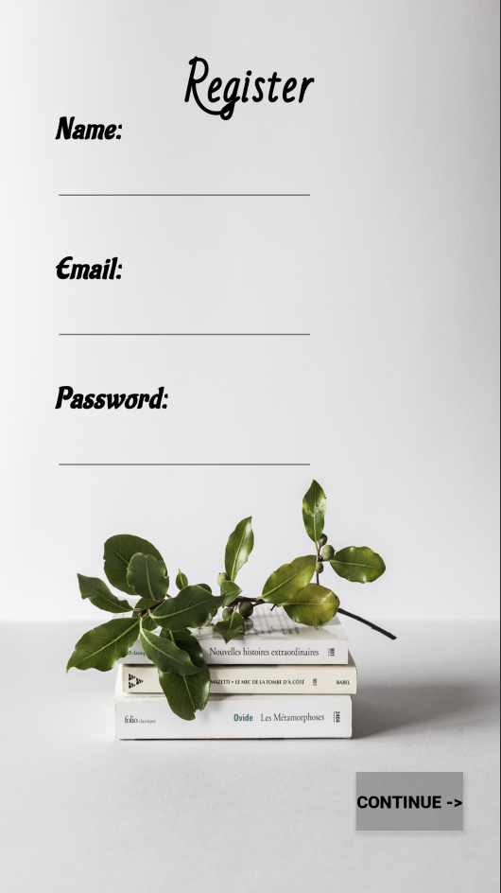
Step 1
Registration
Left screen is the main page.
Click on register to get to the registration page.
Enter your name, email, and password and press continue to complete registration and go back to the login page.
2

Slide 4
Step 2
Signing in
This is the main page.
Re-enter your information in order to login to the app.
Place your screenshot here

Slide 5
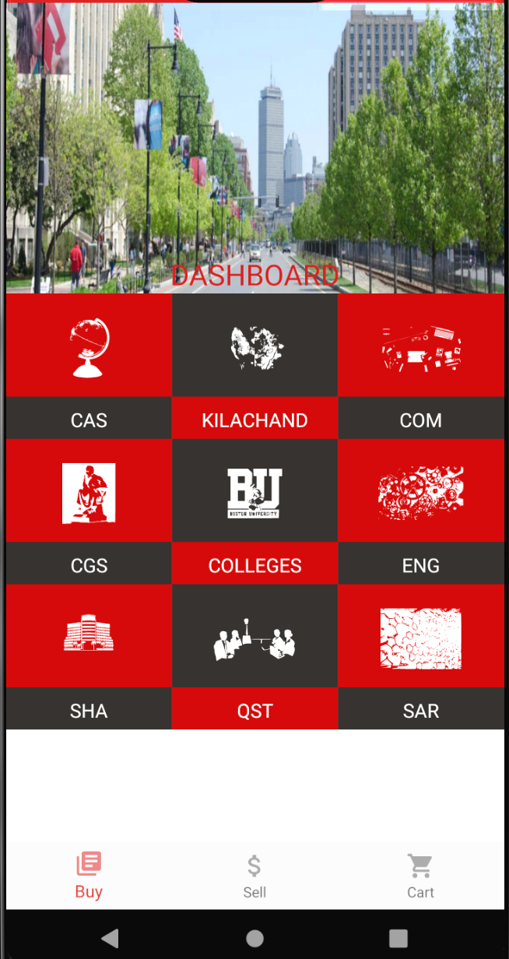
Step 3
Dashboard / Buy Section
Options for 8 colleges within BU will appear
Click on any of these options to browse textbooks within each college
Place your screenshot here

Slide 6
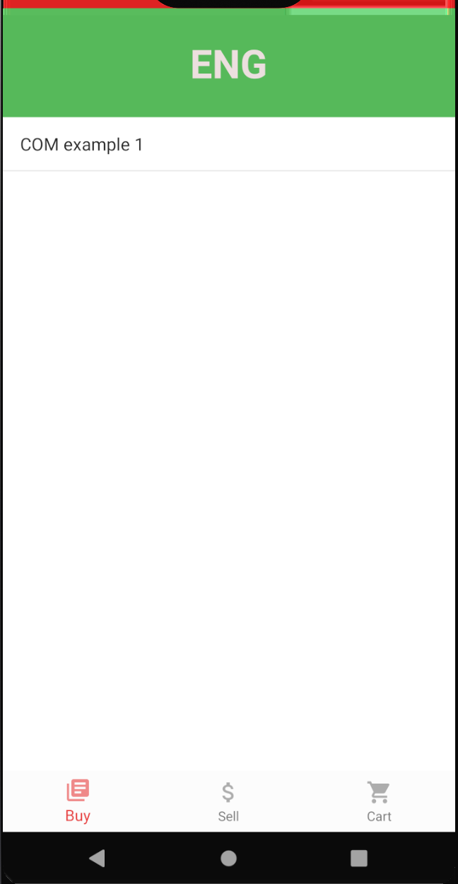
Step 4
College Specific Textbooks Section
Textbooks that other users have entered in the sell function will appear here.

Slide 7
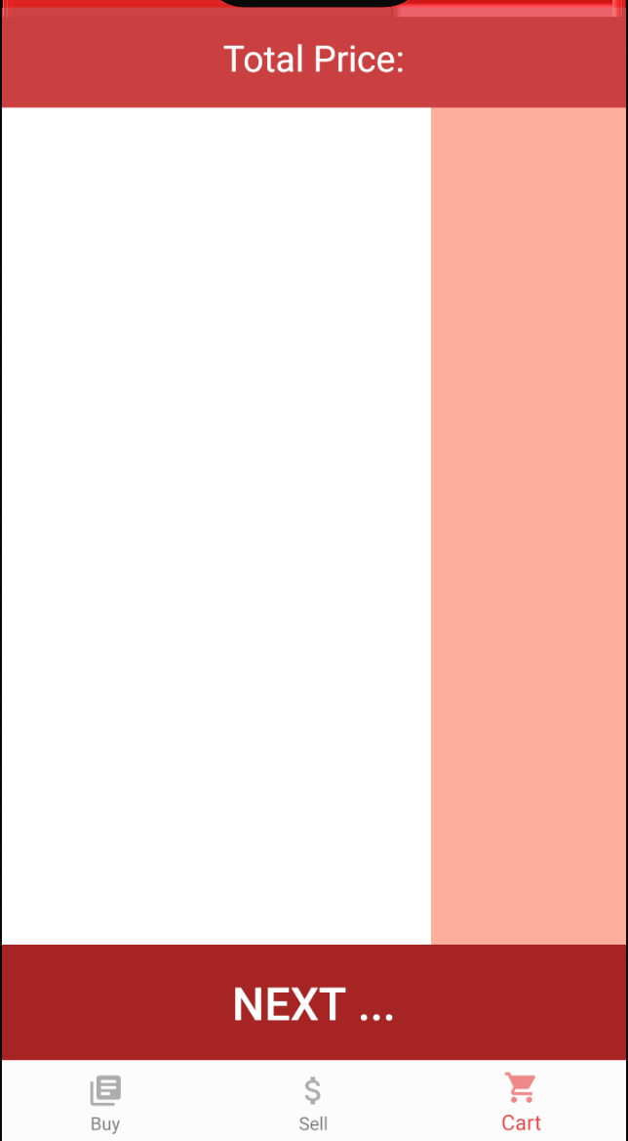
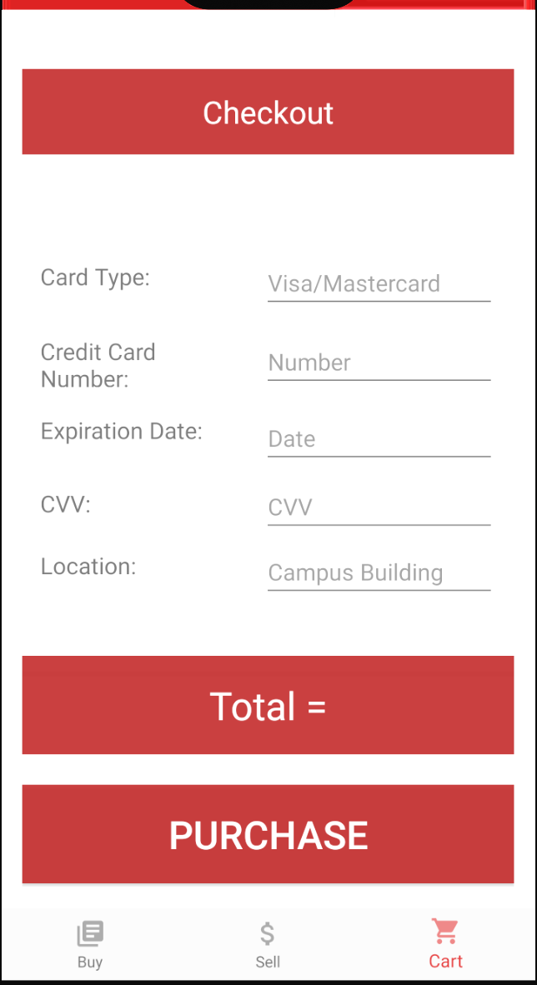
Step 5
Cart
Once the user chooses their textbook they can select the cart function to view their current shopping cart and furthermore proceed to checking out.
Click Next button to go to checkout page.

Slide 8
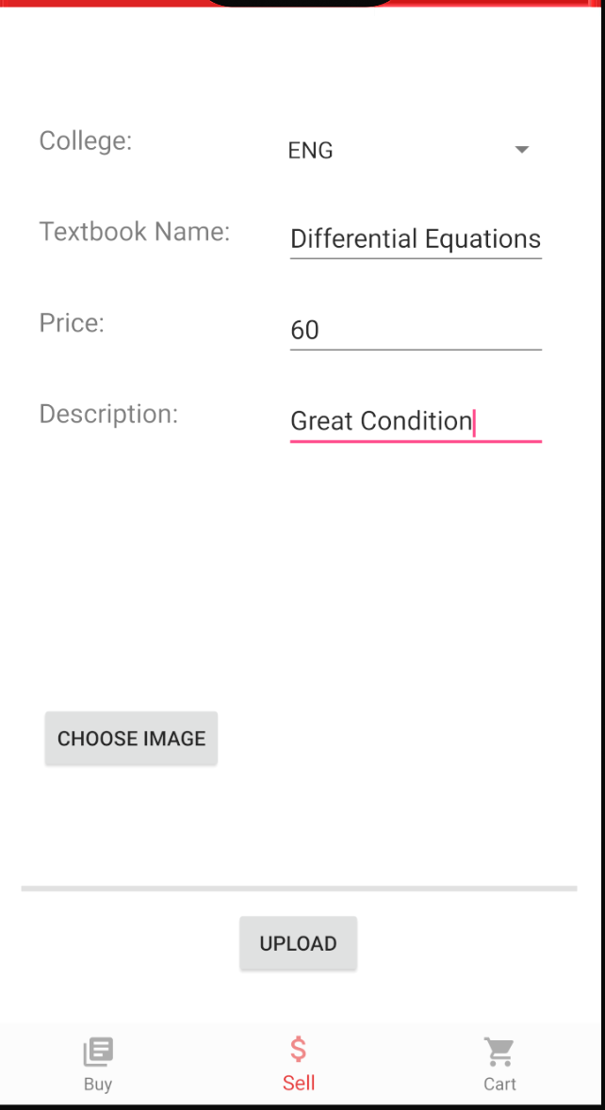
Step 6
Selling College Specific Textbooks Section
Users have a dropdown menu to select which college their textbook correlates to.
Enter the remaining information, after they choose an image they can upload the textbook to the database.

Slide 9
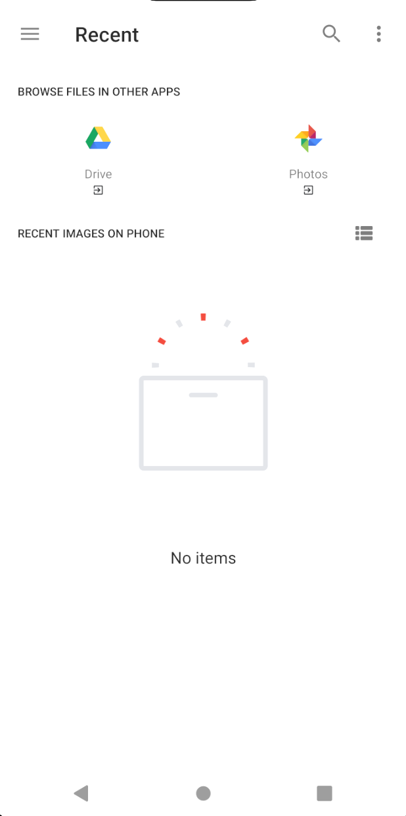
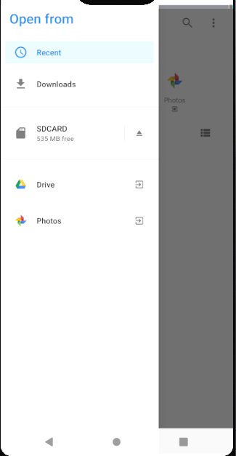
Step 7
Uploading Textbook Pictures
Users can select a picture from their google drive or google photos to go along with their textbook description

